Slide 1

10 Stages of Genocide
Lesson 2

Slide 2
Learning Intention
To develop an understanding of genocide
Success Criteria
By the end of this lesson I will be able to:
  Define the term genocide
  Define the ten stages of genocide

Slide 3
What was the Srebrenica Genocide?
Yugoslavia began to disintegrate in 1991. Two states, Slovenia and Croatia, declared their independence. Six months later, in 1992, Bosnia declared independence. The presidents of Serbia and Croatia join together and carve up Bosnia between themselves. Bosnia has limited weapons, so they were an easy target.
Many of the Bosnia Serb population were unhappy as they wanted to remain in the multicultural Bosnia they were used to and liked. However, Karadžić, the self-appointed leader of the Bosnia Serbs, did not want this to continue. A war against the Bosnian Muslims by the Bosnian Serb army (backed by Serbia) began. It was a war of aggression to destroy a people – Muslims.
And so, in Bosnia in 1992, began the Ten Stages of Genocide. The 5 July 1995 until the 21 July 1995 saw eighteen days of hell reign down on the Bosnian Muslims of Srebrenica.
It was the first genocide on European soil since the Holocaust in the Second World War.

Slide 4

Starter
International law defines genocide as;
“an act ‘committed with intent to destroy, in whole or in part, a national, ethnic, racial or religious group.”
How do you think hatred and prejudice becomes genocide?
Class
Discussion

Slide 5
ACTIVITY - The 10 Stages of Genocide
WHAT TO DO:
You will be working in groups.
Collect a “Ten Stages” pack and match up the following:
The 10 stages of genocide
The definition of each stage
The example at each stage
You have fifteen minutes to complete this task
Classification
Symbolisation
Discrimination
Dehumanisation
Organisation
Polarisation
Preparation
Persecution
Extermination
Denial
ACTIVITY
Paired Work

Slide 6
ACTIVITY - Checking Your Answers
CLASSIFICATION
People are categorised into ‘us and them’
A “Yugoslav” identity was created before the war, but nationalism increased in Croatia and Serbia with the media characterised Bosnian Muslims as ‘Islamic fundamentalists’
SYMBOLISATION
People are made to wear something to show that they are ‘different’
On 31st May 1992, all Bosniaks had to mark their houses with white flags or sheets and to wear a white armband
DISCRIMINATION
A dominant group uses the law, political power and custom to refuse the rights of other groups
Bosnian Muslims were not permitted to register on the census as an ethnic group until 1971

Slide 7
DEHUMANISATION
The humanity of one group is refuted by the other
Biljana Plavšić, President of the self-declared Serb Republic of Bosnia-Herzegovina, stated in 1994 that Bosnian Serbs are ethnically-racially superior to Bosnian Muslims
ORGANISATION
Careful planning takes place. Training begins at a young age
Serbian paramilitary units, such as the Scorpions, filmed the execution of young Bosnian Muslim men
POLARISATION
Propaganda is used to spread ideas and often to breed hatred
Anti-Muslim propaganda persuaded ordinary Bosnian Serbs they needed to defend themselves against slaughter and rape from their Muslim neighbours

Slide 8
PREPARATION
People are indoctrinated with fear and suspicion of the victim group
Anti-Muslim propaganda persuaded ordinary Bosnian Serbs they needed to defend themselves against slaughter and rape from their Muslim neighbours
PERSECUTION
Victims are identified and separated because of their religion or ethnic identity
In a directive ordered by Karadẑić in March 1995 Bosnian Serbs were ordered to create insecurity and hopelessness in the inhabitants of Srebrenica

Slide 9
EXTERMINATION
Victims are murdered
From 1993 there was a “slow motion” genocide of Bosnian Muslims was taking place. The international community failed to heed these warnings, leading to the events at Srebrenica in July 1995
DENIAL
The perpetrators or later generations deny the event
Serbian denial of the genocide: hiding of bodies; alleging that Bosnian Muslim forces killed each other; all sides committed equal atrocities

Slide 10
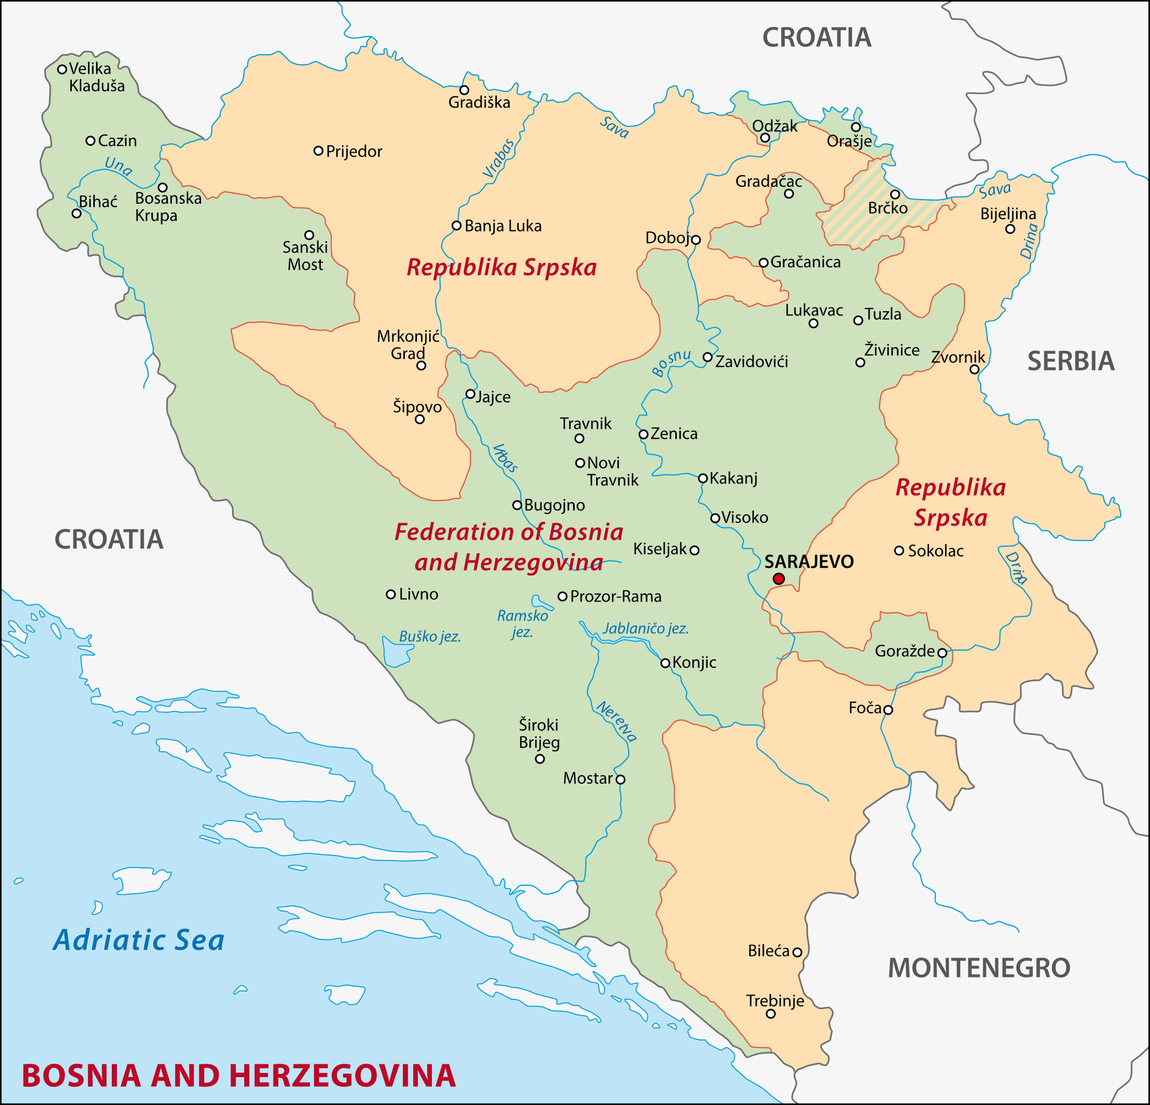
Plenary
Republika Srpska is an area within BiH where the majority of the Bosnian Serb population live. Look at the map opposite, the star represents Srebrenica.
International law defines genocide as;
“an act ‘committed with intent to destroy, in whole or in part, a national, ethnic, racial or religious group.”
Why do you think the genocide took place here?

