Slide 1

Gender and Genocide
Lesson 3 and 4
Notes:
This lesson contains a number of sensitive issues- teacher discretion required. Class maturity must be considered before delivering the lesson.

Slide 2
Learning Intention
To be able to explain the role of gender in the Bosnian genocide.
Success Criteria
I can define gender.
I can define genocide.
I can define ethnic cleansing.
I can explain why Srebrenica is seen as an example of ‘gendercide’.

Slide 3

Key Terms
Srebrenica was the final act in a genocidal plan aimed at Bosnian Muslims, who are often referred to as Bosniaks. Before we begin, it is important that we understand what is meant by the terms gender, genocide, and ethnic cleansing.
You have one minute to think about what these terms mean and to share your ideas with the person next to you. Be prepared to discuss with the rest of the class.
Notes:
Teacher notes: Class discussion follows this slide.

Slide 4
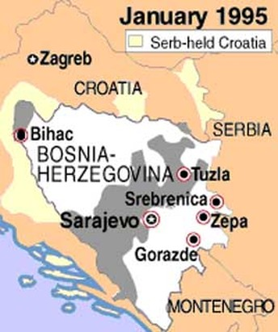
Srebrenica Massacre
The Massacre of Srebrenica was the systematic murder of 8,000 Bosnian Muslim boys and men and the systematic rape of Muslim women.
During the Bosnian War, Srebrenica was known as a safe zone as protected by the United Nations.
What does it mean if somewhere is a safe zone?
What was the role of the UN here?

Slide 5
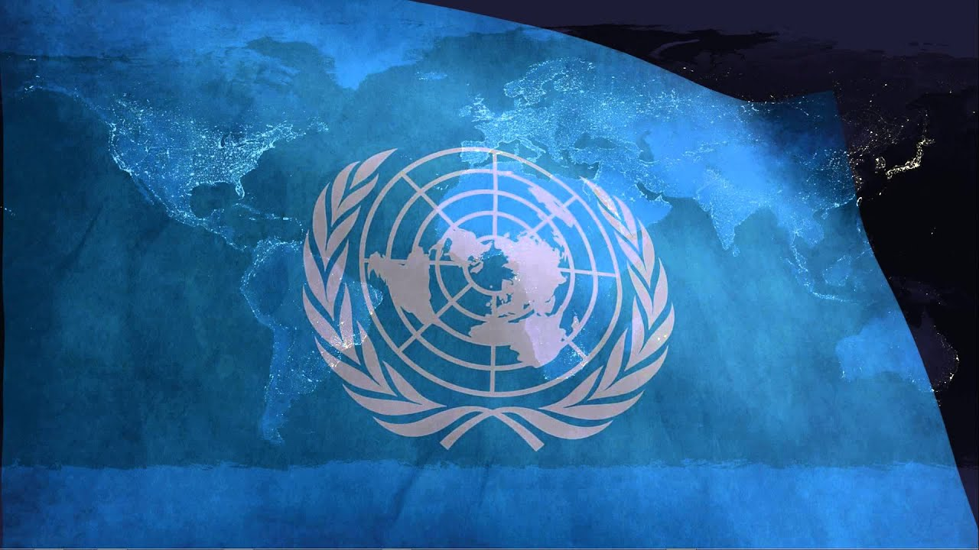
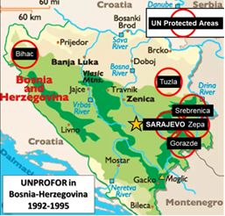
United Nations Safe Area
On the 16th April, 1993, Srebrenica was declared a safe area; meaning it was to be demilitarised.
However, both sides (the Republic Srpska and the Army of the Republic of Bosnia and Herzegovina) broke this rule and continued to militarise within and around Srebrenica.
The reason for this was the disparity on weaponry. Whilst the Serbs had access to modern warfare, and lots of it, the Muslim Bosniaks were unorganised and had access to little weaponry.
Attempts by the UN to demilitarise this area failed, with the Serbs hiding their weaponry and refusing to withdraw their heavy weaponry.
safe area
Notes:
What does disparity mean? Why is that important here? Why does the disparity mean both sides maintain their weapons? Ask pupils to consider the problems caused by two safe areas being attacked?

Slide 6





Why was Srebrenica called a “Gendercide?”
Class Discussion
Answer: Gender influenced what happened to people
Bosnian men and boys - murdered
Bosnian women and girls - victims of rape and sexual assault

Slide 7
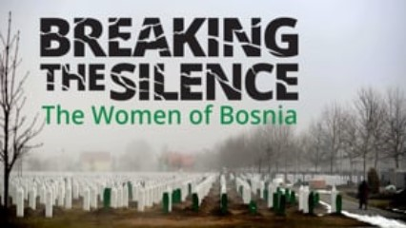
Breaking the Silence
In this clip we hear about the differing experiences of men and women during the genocide, and how their genders impacted the violence inflicted on them.
Notes:
Breaking the Silence - Women of Bosnia (Remembering Srebrenica) - Start of the Video - 2 mins 48 secs - Differing Experiences of Men & Women: https://vimeo.com/840427184

Slide 8
Breaking the Silence
A large part of the campaign led by some of the victims of the ‘gendercide’ is to ‘break the silence’.
Why is this important?
What are they trying to
achieve?
Class Discussion

Slide 9
Breaking the Silence
Due to the stigma and shame women do not speak out; the campaign is to encourage them to do so. The campaign is also to encourage men to accept the trauma the women in their family went through and provide them with support.
It is about women’s voices being heard, that are so often forgotten in a time of conflict or war. Why are they forgotten? Because war is seen as a man’s domain, and rape is accepted and seen as collateral damage in war.
You are about to watch a clip which explains the importance of having these discussions.

Slide 10
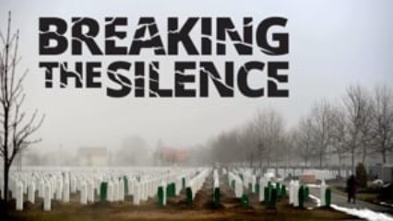
Breaking the Silence

Slide 11
Activity - Comparing Experiences Article
Let’s think about how men and women’s experiences in the Bosnian genocide differed.
Your task is to use the information packs you’ve been given and what you’ve heard in the clips to compare their experiences.
To do this you should copy the table from the following slide. You have 25 minutes to do this.
NOTE: The table should fill your jotter page.
Notes:
From thereBreaking the Silence (Remembering Srebrenica) - Whole Clip - https://vimeo.com/840423448

Slide 12
Gendercide | Men | Women
Numbers
Types of atrocities
Quotes from survivors
Words used to express their feelings
Legacy
Notes:
From Breaking the Silence (Remembering Srebrenica) - Whole Clip - https://vimeo.com/840423448

Slide 13
Plenary
As young historians...
Why do you think it’s important to use testimonies from victims in Bosnia?
How does this improve your
understanding of the Bosnian
genocide and why it’s called a
‘gendercide’?
Class Discussion

