Slide 1

Perpetrators, Collaborators & Bystanders
Lesson 7

Slide 2
Learning Intention
To develop an understanding of the concept of responsibility.
Success Criteria
By the end of this lesson I will be able to: ​
Identify those who were perpetrators, collaborators and bystanders during the Srebrenica genocide.

Slide 3

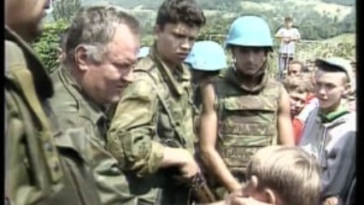
Starter
Class Discussion
Why do you think the genocide is still taboo? Why do you think this would make it difficult to punish those responsible?
Notes:
Srebrenica Massacre: Stories of War Crimes Still Taboo 20 Years On (Channel 4 News) - Whole Clip: https://vimeo.com/840433691

Slide 4
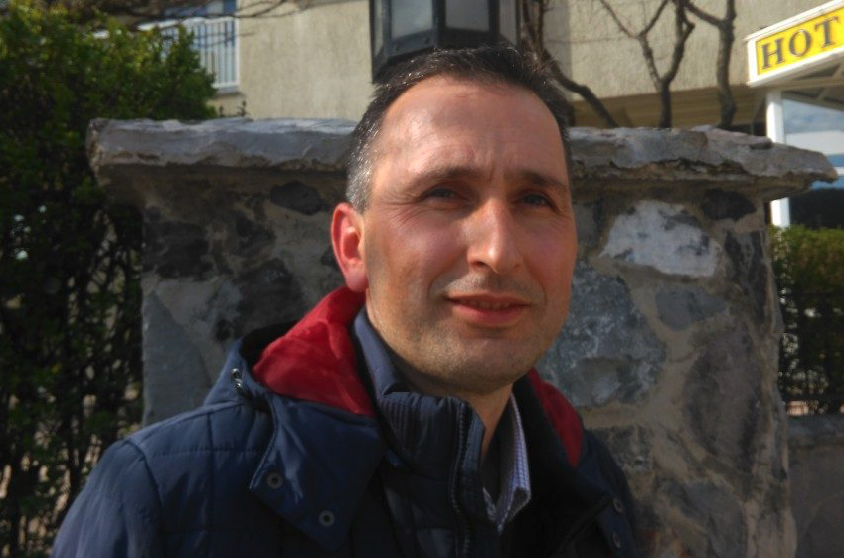
Hajrudin Mesić
This is Hajrudin Mesić. He is the youngest of five brothers and is the only one of his siblings to survive the Srebrenica genocide. He was 21 when it happened.
Who do you think is responsible for the death of Mesić’s family?
Notes:
Explain that this workshop will be about understanding genocide and what can happen in the lead up to genocide. The first step is agreeing what the term ‘genocide’ means – ask students to discuss in their groups what they understand genocide to mean.
Use Mesic

Slide 5
During the Srebrenica genocide people who were not victims could be divided into 4 categories
Perpetrator
Collaborators
Bystanders
Resisters
Ordered, organised
or carried out the persecution/ killing.
Supported the Bosnian Serb soldiers. Helped make the killing possible.
Did nothing to support the Bosnian Serb soldiers or to help their victims.
Saved
people or tried
to stop the
Bosnian Serb soldiers.
Notes:
Share the officially recognised definition of genocide:
Genocide – defined in international law as an act ‘committed with intent to destroy, in whole or in part, a national, ethnic, racial or religious group.
Genocide is generally carried out through the attempted killing of all members of a group, but can also be classified as deliberately ‘placing a group in conditions calculated to prevent their survival’.

Slide 6
Who did what?
You are going to look at a number of different individuals and groups who played a role in the Srebrenica genocide.
It is your task to decide whether the individual/group were either:
Perpetrators
Collaborators
Bystanders
Notes:
Explain that this workshop will be about understanding genocide and what can happen in the lead up to genocide. The first step is agreeing what the term ‘genocide’ means – ask students to discuss in their groups what they understand genocide to mean.

Slide 7

Activity
Round the room are examples of individuals and groups involved in the Srebrenica genocide.
It is your task to read these and decide whether the individual or group
were either perpetrators, collaborators or bystanders and to provide
evidence to support this.
You have 20 minutes to read and make notes about the
above task. To do so you should copy and complete the
table on the next slide. One example has been completed to
show you what to do.
NOTE: The table should fill your jotter page. Ignore the final
column you will return to that in a later lesson.
Notes:
Explain that this workshop will be about understanding genocide and what can happen in the lead up to genocide. The first step is agreeing what the term ‘genocide’ means – ask students to discuss in their groups what they understand genocide to mean.

Slide 8
Individual/Group | Who are they? | Role? P, C or B | Evidence | Could they have done anything differently?
Radislav Krstić
Radovan Karadžić
Ratko Mladic
Media Propaganda
United Nations | A group of countries working together to maintain peaceful relations. | Collaborators | Paid for fuel for the busses which transported the Bosnians to camps and sites where they were murdered.
General Janvier
Dutch UN Peacekeepers
Camera Crews
US & UK

Slide 9
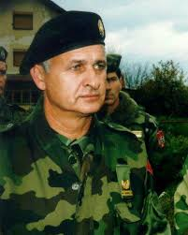
Radislav Krstić
Who are they?
General Major in the military and was in command of the Drina Corp.
Role? P, C or B
Perpetrator
Evidence
Separated Muslim men of military age in Srebrenica from the rest of the population and led them to detention centres.
Could they have done anything differently?
He could have denied his resources to be used to commit genocide.

Slide 10
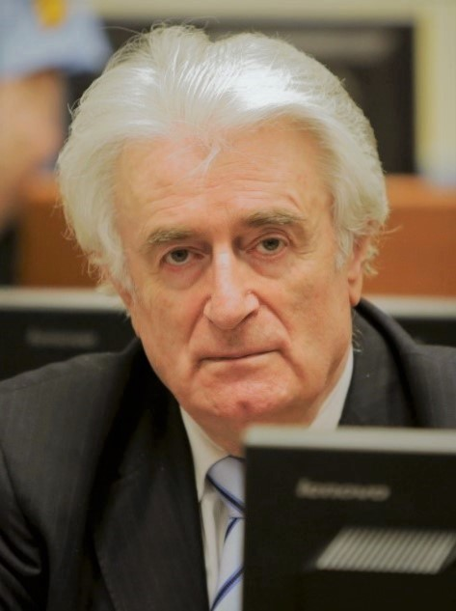
Radovan Karadžić
Who are they?
Leader of the Serb Democratic Party in Bosnia and President of the Serb Republic within Bosnia.
Role? P, C or B
Perpetrator
Evidence
Was held responsible for the ‘ethnic cleansing’ of Serb held areas of Bosnia, during which tens of thousands of Bosniaks (Muslims) and Croats were killed or driven from their homes.
Could they have done anything differently?
Did not have to order the murder of more than 7’000 Bosniaks in the town of Srebrenica in July 1995.

Slide 11
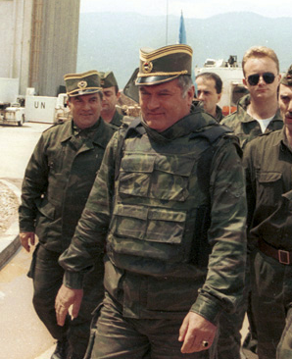
Ratko Mladic
Who are they?
Commander of the Bosnian Serb army during the Bosnian conflict.
Role? P, C or B
Perpetrator
Evidence
Mladic oversaw the Srebrenica massacre, where at least 7’000 Bosniak (Bosnian Muslim) men and boys were killed.
Could they have done anything differently?
Could have refused to oversee the Srebrenica massacre.

Slide 12

Media Propaganda
Who are they?
Media outlets such as; newspaper, TV and radio which share news in Bosnia.
Role? P, C or B
Collaborator
Evidence
Throughout the war, media outlets such as Belgrade TV and radio spread lots of anti-muslim propaganda.
Could they have done anything differently?
Did not have to spread anti-muslim propaganda.

Slide 13
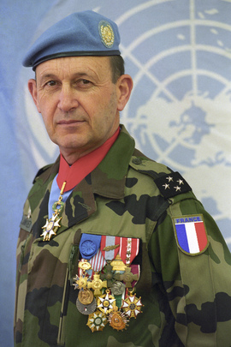
General Janvier
Who are they?
Former General of the French army and was in charge of peacekeeping during the Bosnian war.
Role? P, C or B
Collaborator
Evidence
Six weeks before Bosnian Serb forces overran Srebrenica and murdered thousands of its inhabitants, General Janvier told UN diplomats to abandon the Muslim enclave and the other so-called "safe areas" in Bosnia to their fate.
Could they have done anything differently?
Could have told UN diplomats to continue sustain the Muslim enclave and other ‘safe areas’.

Slide 14


The US and UK do nothing
Who are they?
Governments of western countries such as the US and UK.
Role? P, C or B
Bystander
Evidence
New research reveals that Britain and the US knew six weeks before the massacre that enclave would fall – but they decided to sacrifice it in their efforts for peace.
Could they have done anything differently?
The US and UK governments could have chosen to step in to support the Bosniaks.

Slide 15
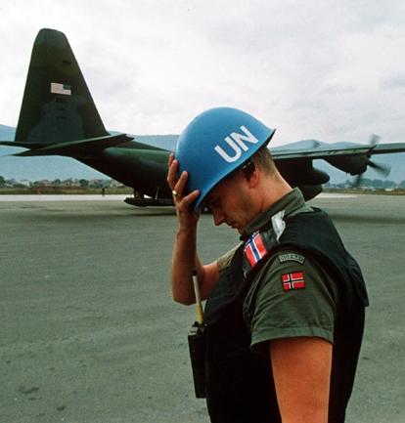
Dutch UN Peacekeepers
Who are they?
Dutch soldiers acting as UN peacekeepers.
Role? P, C or B
Bystander
Evidence
Bosniak Muslims headed to the nearby Dutch base, only to be subsequently handed over to their murderers as UN peacekeepers did nothing to protect them.
Could they have done anything differently?
UN Dutch peacekeepers could have defended Bosniak Muslim men and boys who came to the base for protection.

Slide 16
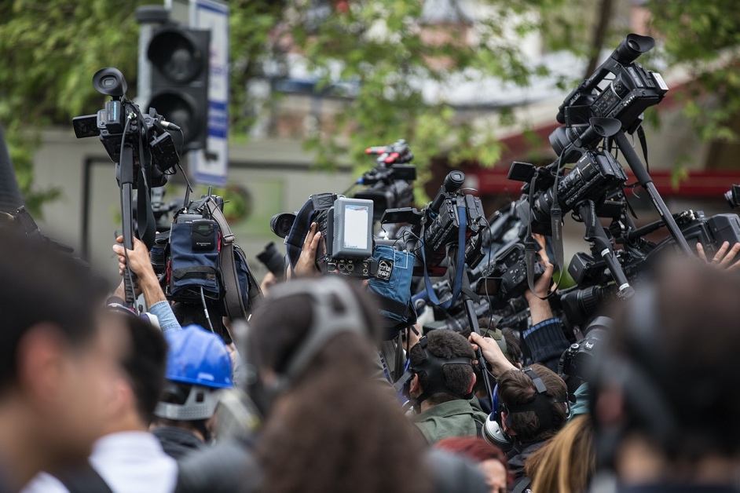
Camera Crews
Who are they?
Camera crews from media outlets across the West.
Role? P, C or B
Bystander
Evidence
Camera crews were very aware of the atrocities which were happening in front of them however they decided to film what was happening rather than put a stop to it.
Could they have done anything differently?
Camera Crews could have chosen not to film the atrocities and publicise the violence.

Slide 17
Plenary
We have now considered the role of a number of different groups and individuals who played a part in the Srebrenica genocide.
Has this changed your mind about who was responsible?
On your post it write who you now think was responsible for the death of Hajrudin Mesić family.
Exit Pass

